Slide 1
Strengthening Teaching Competences in Higher Education in Natural and Mathematical Sciences
Project Website
and Project Management Application
Ivan Jocic
University of Niš, Serbia
Kick-off Meeting, Niš, January 15-17, 2019

Slide 2
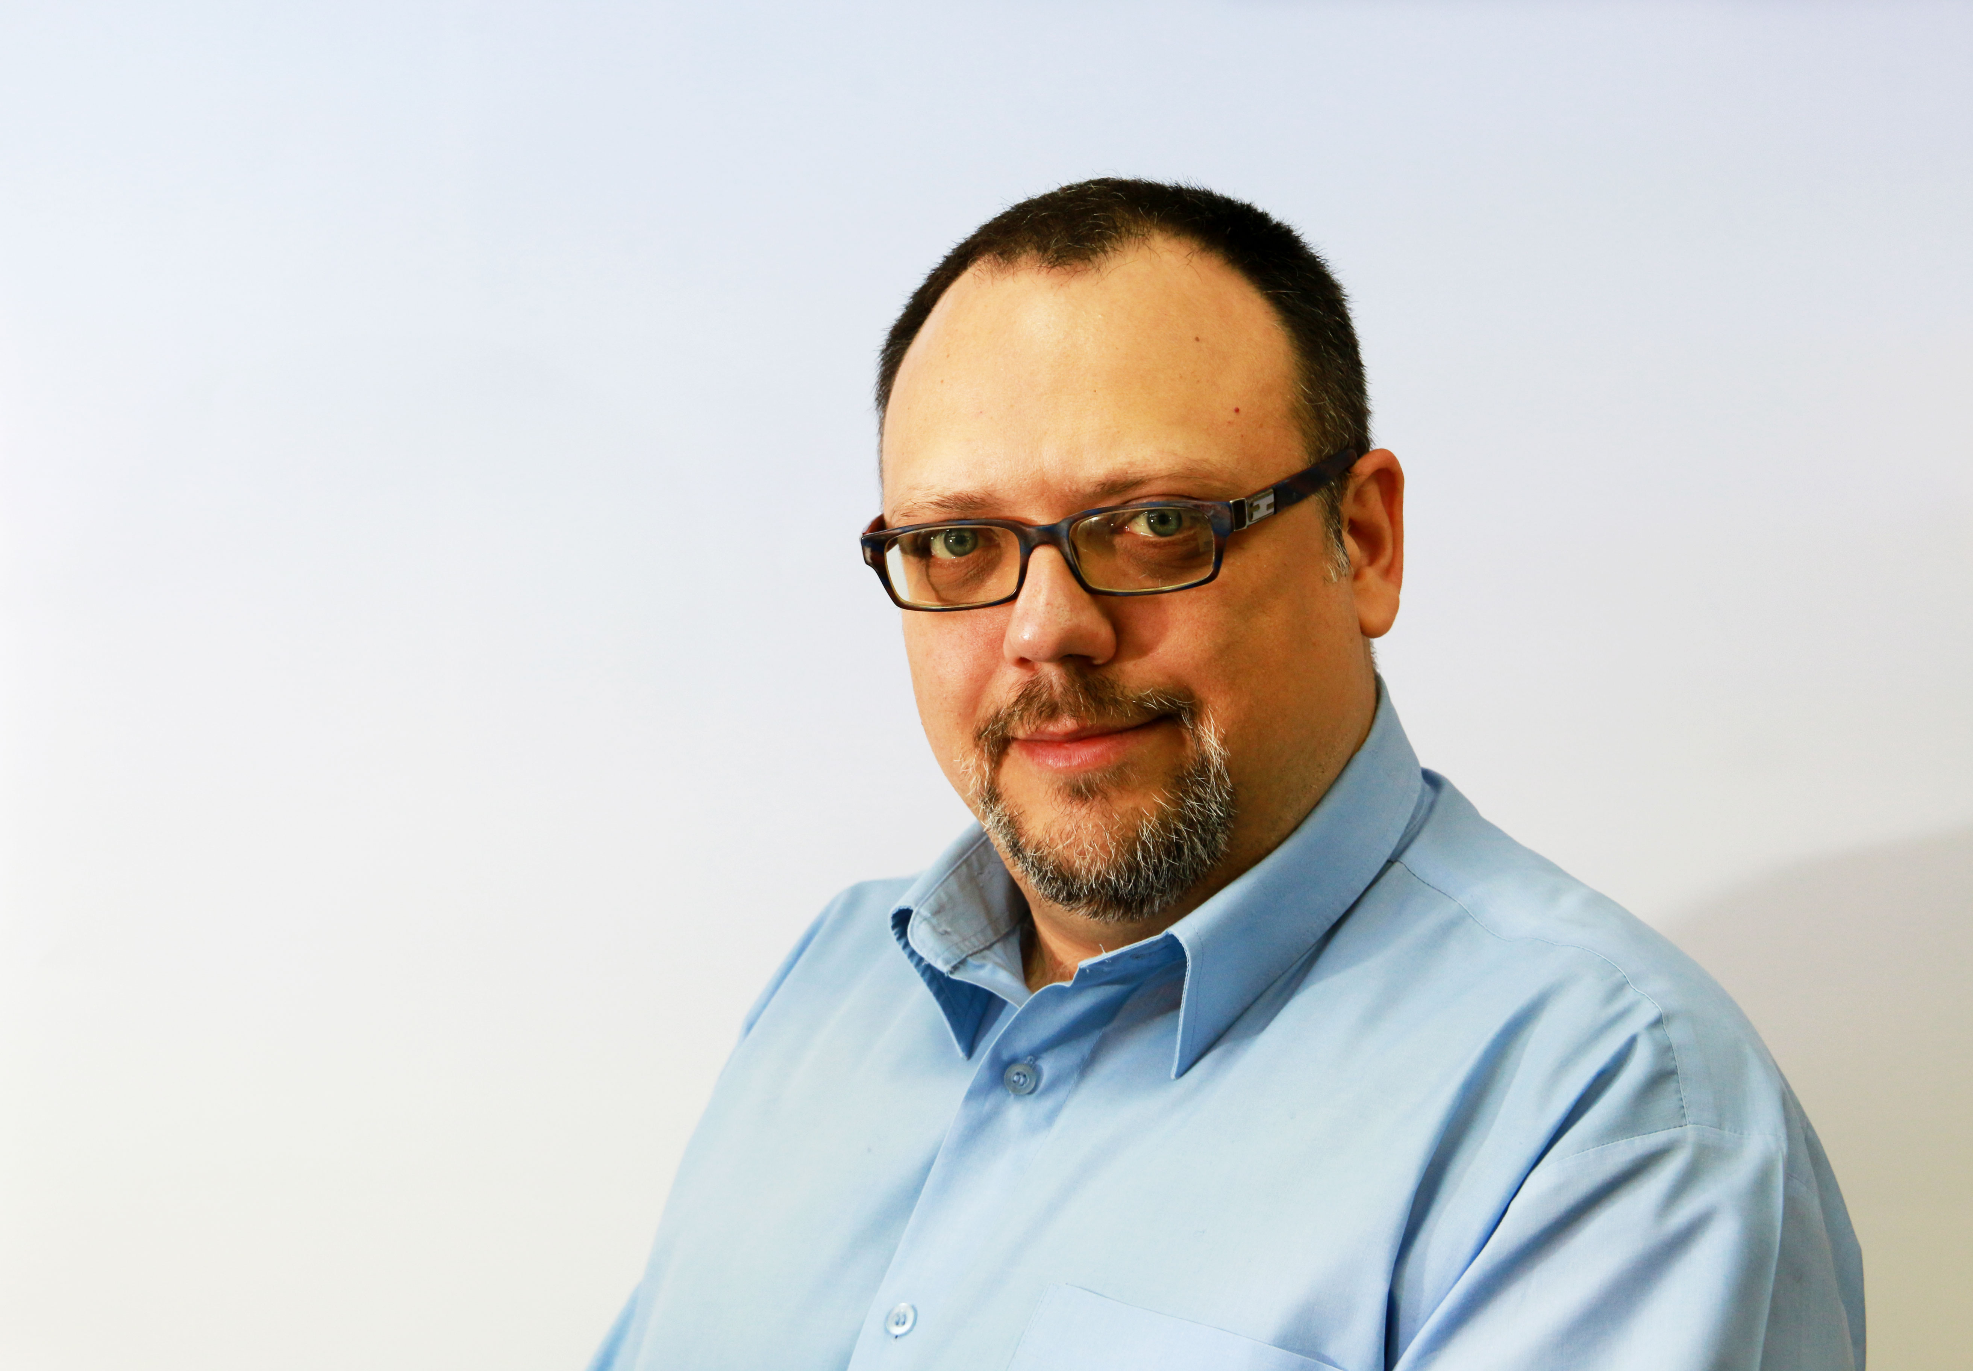
Hello everyone!
Ivan Jocic (Иван Јоцић)
IT specialist
ivan.jocic@pmf.edu.rs
iki.jocic@gmail.com
www.linkedin.com/in/ivanjocic

Slide 3
We’ll talk about
Project web site
Project management application

Slide 4
www.tecomp.ni.ac.rs
Wordpress
Site structure follows the TeComp project logic:
Summary, Objectives, Activities, Logical Framework Matrix, Work Packages, Project Partners, Project Teams
Documents
Events
Dissemination
News
PMA (project management application – link to Trello)

Slide 5
www.tecomp.ni.ac.rs
Project
Project Partners
Project Teams

Slide 6
www.tecomp.ni.ac.rs
Project
Project Partners
Project Teams

Slide 7
www.tecomp.ni.ac.rs
Project
Project Partners
Project Teams

Slide 8
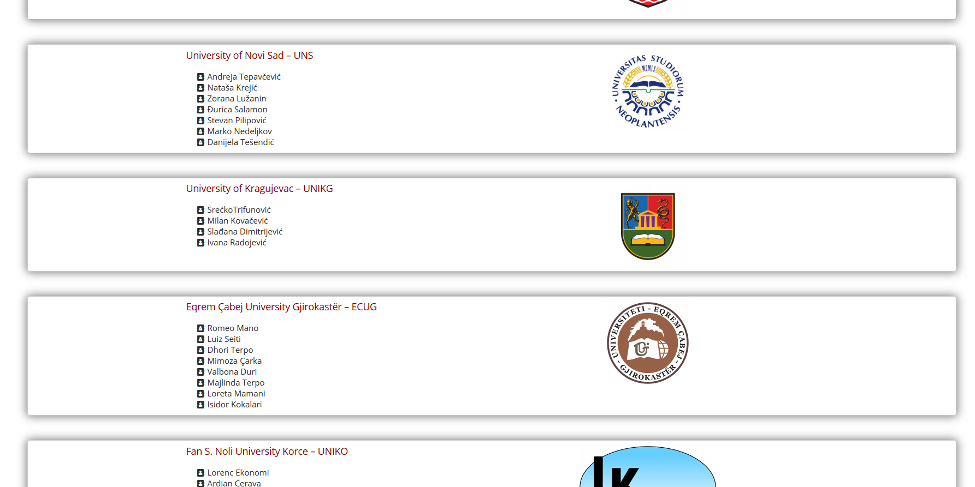
www.tecomp.ni.ac.rs
Project
Project Partners
Project Teams

Slide 9
www.tecomp.ni.ac.rs
Project
Project Partners
Project Teams
Personal web presentation URL
tecomp@ni.ac.rs

Slide 10
Trello
Web based project management tool
https://trello.com/
Helps to stay organized and on track
We choosed Trello ‘cause it’s:
Simple to configure
Simple to use – novice friendly, no overkill
Flexible
Visual representation of our work progress

Slide 11
Trello - terminology
Trello organisational units:

Slide 12
Trello - terminology
Trello organisational units:
Team
Board
List
Card
+ Checklist
From largest to smallest

Slide 13
Trello – corelation with project terminology
Trello
TeComp
Team
Project teams
Boards
Work Packages
Lists
Task status
Task
Card
Eventual subtasks
Checklist

Slide 14
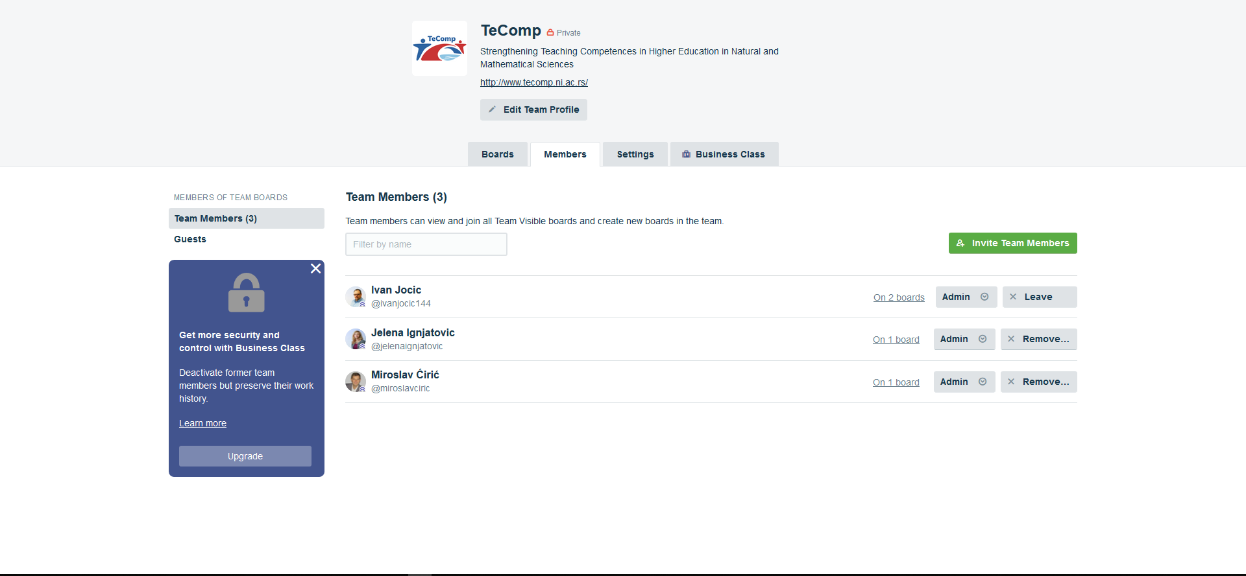
Trello – team

Slide 15
Trello – team
To avoid confusion
Two persons from each university

Slide 16
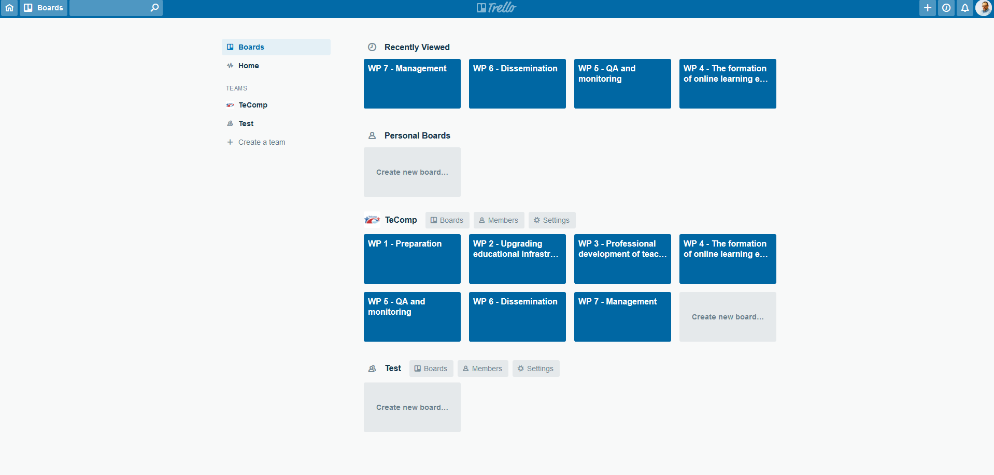
Trello – boards

Slide 17
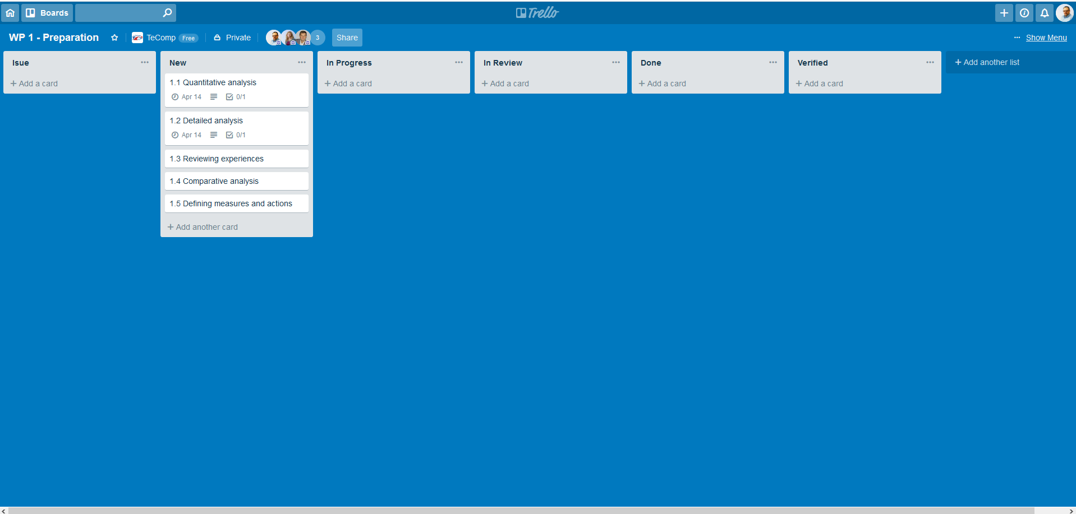
Trello – lists

Slide 18
Trello – lists
Moving left to right
Task Manager:
New > In Progress > In Review
Only General Project Panager:
In Review > Done > Verified

Slide 19
Trello – lists
if (issue) {
move.left();
}
Anyone

Slide 20
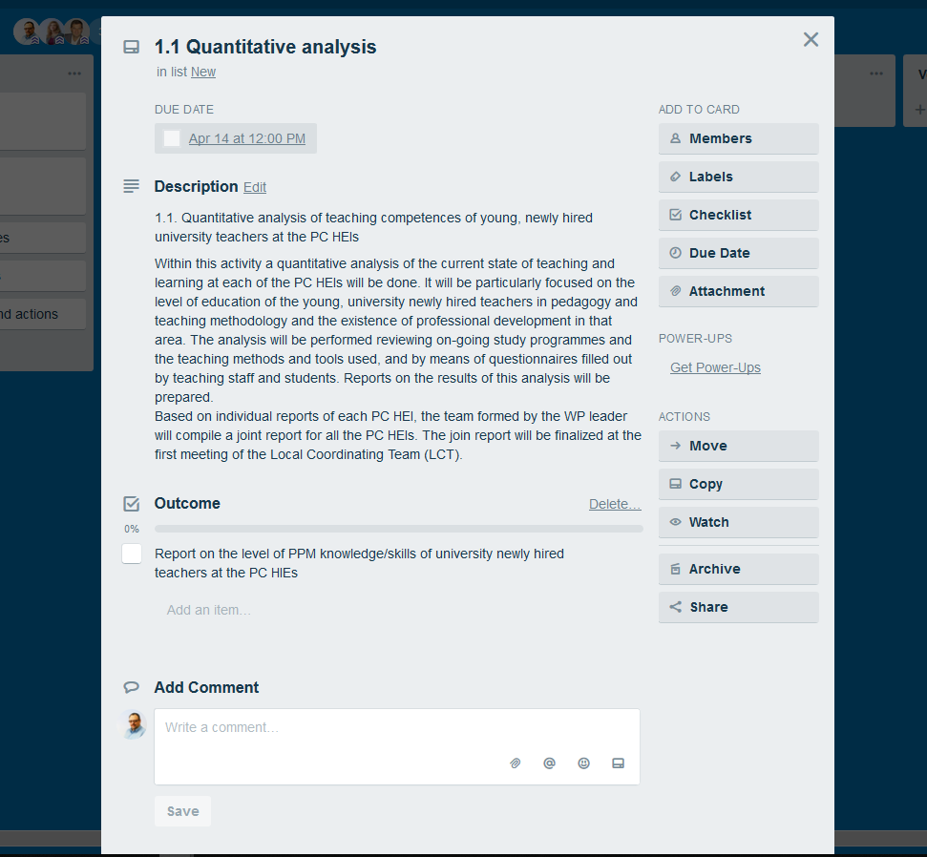
Trello – card

Slide 21
Trello – card
Task name
Due data
Description
Checklist (outcome)

Slide 22
Trello – card

Slide 23
Trello
Enough of theory
Let us get our hands dirty
Let’s try application

Slide 24
Further watching
https://www.youtube.com/watch?v=zzwovrD0vM4
https://www.youtube.com/channel/UCRcOkXoOrU6sN1yCz20VmQw
https://www.youtube.com/watch?v=OUwhjnooyF8&t=104s

Slide 25
In the End…
Remember your system administrators on
System Administrator Appreciation Day
July 26, 2019 (last Friday in July)– 20th Annual
quiet people who make things running

